Slide 1
Types of Trademarks

Slide 2
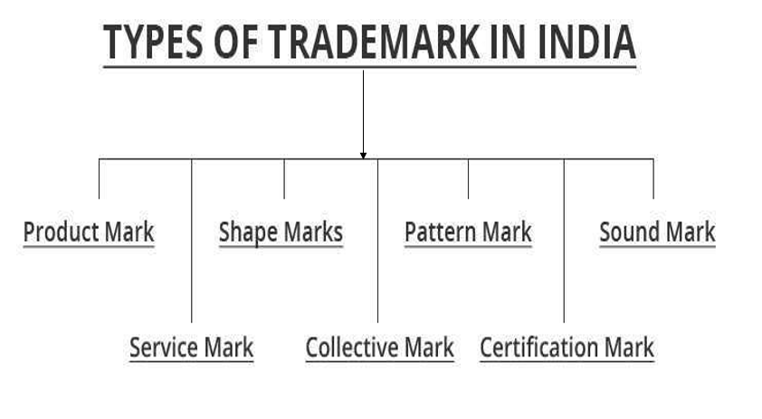

Slide 3
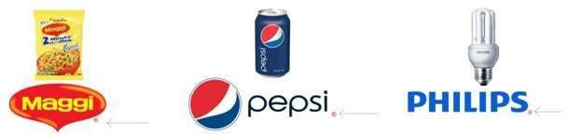
Product Mark
Similar to trademark
Identify the products or goods instead of services
Product is the unique selling feature of the company
Initially, TM, which states that the mark is not yet registered.
Once they are registered, they have to use ®.
Examples: Pepsi®, Maggi®, PHILIPS® etc.

Slide 4
Examples of Product Marks:
Apple's Logo
Nike's Swoosh
Coca-Cola
Notes:
Apple's Logo: The iconic bitten apple logo is a product mark associated with Apple devices like iPhones, iPads, and MacBooks.
Nike's Swoosh: The swoosh logo is a product mark that identifies Nike's athletic footwear and apparel.
Coca-Cola: The distinctive script logo and name represent the Coca-Cola brand and its beverages.

Slide 5
Service Mark
Identify and distinguish the services rather than the products
Symbol is SM and not TM.
Features of a Service Mark
Service Identification
Source Indicator
Non-Tangible Association
Notes:
Service Identification: It is used to identify and promote services rather than goods.
Source Indicator: It signifies the origin of the service, helping consumers associate it with a particular business.
Non-Tangible Association: Unlike product marks, service marks are linked to non-physical offerings like hospitality, education, or financial services.

Slide 6
Examples of Service Marks:
FedEx:
McDonald's Golden Arches
Netflix
American Airlines Logo
Notes:
FedEx: The name and logo represent shipping and delivery services.
McDonald's Golden Arches: Associated with the restaurant and food service industry.
Netflix: The name and logo are service marks for online streaming services.
American Airlines Logo: Identifies airline transportation services.

Slide 7
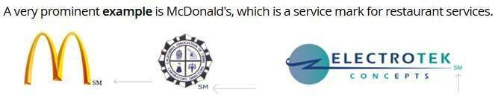

Slide 8
Collective Mark
A collective mark is owned by a collective
Identify their goods and services
Distinguish their goods and services from those of non-members
Indicate membership in the group.
Notes:
Tata Motors
Tata Steel

Slide 9

Examples
Notes:
Examples are like "CA" device is used by the members who fall under Institute of Chartered Accountants; another example is "CPA" which denotes members of the Society of Certified Public Accountants.

Slide 10
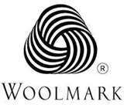

Certification marks
Define "standard" of goods and services.
Examples of common certification marks include:
UL (Underwriters Laboratories
Fair Trade
Energy Star .
Organic Certification
Notes:
Woolmark, which is certified for the fabrics on clothing, Agmark, and ISI.
UL (Underwriters Laboratories): Indicates safety and quality standards for electrical devices.
Fair Trade: Ensures products meet ethical and sustainable production practices.
Energy Star: Certifies energy-efficient appliances.
Organic Certification: Verifies organic farming and production practices.

Slide 11
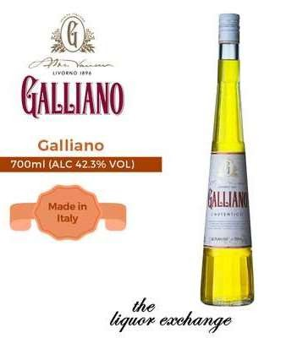
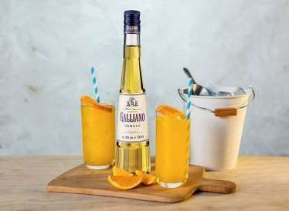
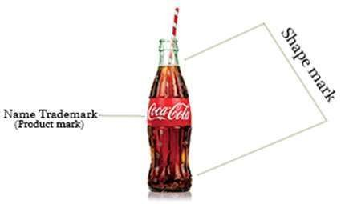
Shape Marks
Type of trademark that protects the three-dimensional shape
Configuration of a product or its packaging
Granted when the shape of the product itself is distinctive and capable of functioning as a source identifier for consumers
Non-traditional trademarks because they go beyond the standard text or logo-based trademarks.
Notes:
Shape marks are a specific type of trademark that protects the three-dimensional shape or configuration of a product or its packaging. These marks are granted when the shape of the product itself is distinctive and capable of functioning as a source identifier for consumers. Shape marks are considered non-traditional trademarks because they go beyond the standard text or logo-based trademarks.

Slide 12
Pattern Mark
Trademark that protect a specific pattern or design
Pattern or design used consistently to identify the source of goods or services
Examples of Pattern Marks
Gucci GG Pattern
Louis Vuitton's Monogram Pattern

Slide 13
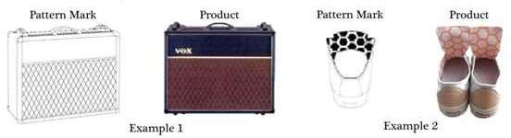

Slide 14
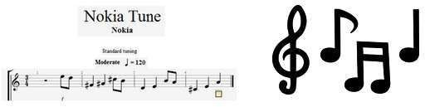
Sound Mark
Trademark that protect a specific sound or combination of sounds
Sounds used to identify and distinguish the goods or services of a particular brand
Segistered when the sound is distinctive enough to be recognized by consumers

Slide 15
Loss of Rights
Improper use:Using the trademark incorrectly (e.g., changing its form or using it inconsistently). Weakens its distinct identity.
Genericide:When a trademark becomes a common word used by the public. Example: “Aspirin”
Non-use:If the trademark is not used for a long time, rights can be revoked
Improper assignment:Transferring or licensing the trademark without quality control or licensing.

Slide 16
Failure to police: When the owner does not properly monitor or enforce trademark rights against misuse or infringement.
Failure to renew: When Owner does not renew their registered trademark after the prescribed period, leading to loss of protection.
Cancellation: Removal of a registered trademark from the official register, resulting in loss of legal protection.

Slide 17
Benefits of Registration of a trademark
Registration is prima facie evidence of proprietorship of the trademark
It gives the exclusive right to use the trademark in respect of goods/services; and to take legal action in case of infringement
The registered proprietor may assign or license the trademark as any other property
The registered proprietor can enjoy the Goodwill associated with registered trademark forever, if the mark is renewed from time to time

